Slide 1
Functions

Slide 2
Learning Objectives
To understand what a function is, how to define it, and when to use it
Understanding the difference between an argument and a parameter
Understanding when to use keyword and positional arguments

Slide 3
Functions are blocks of code designed to do a specific job
If you want to use the function you have defined, you need to call on the function. Why are functions useful? It means that instead of writing out block of code several times, you can just call on the function instead.
Not only can you do this within the same code, but you can also store your functions in different files and call on them from a single file!

Slide 4
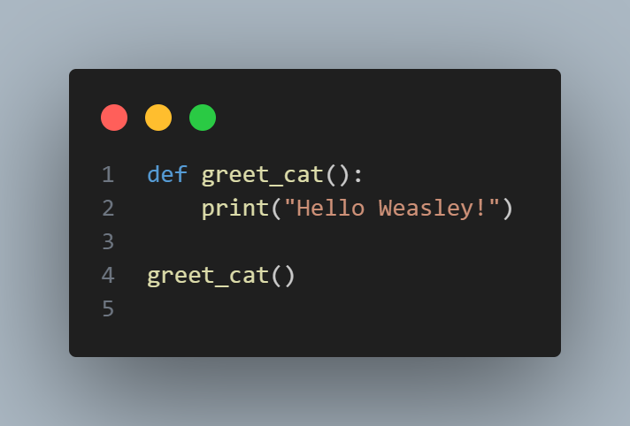
A Very Simple Function…
Notes:
def greet_cat():
print("Hello Weasley!")
greet_cat()
What would happen if I ran this?

Slide 5
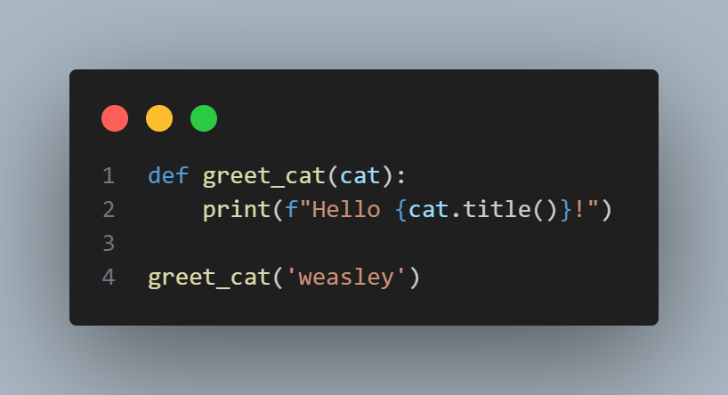
Expand on it by passing information…
Notes:
def greet_cat(cat):
print(f"Hello {cat.title()}!")
greet_cat('weasley')

Slide 6
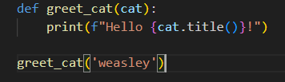
Arguments and Parameters
Parameter: the information the function needs to do its job
WARNING: These can be used interchangeably.
Argument: information that is passed from a function call to a function so it can do its job

Slide 7
Passing Arguments
Positional Arguments: same order the parameters were written
Keyword arguments: each argument consists of a variable name and a value

Slide 8
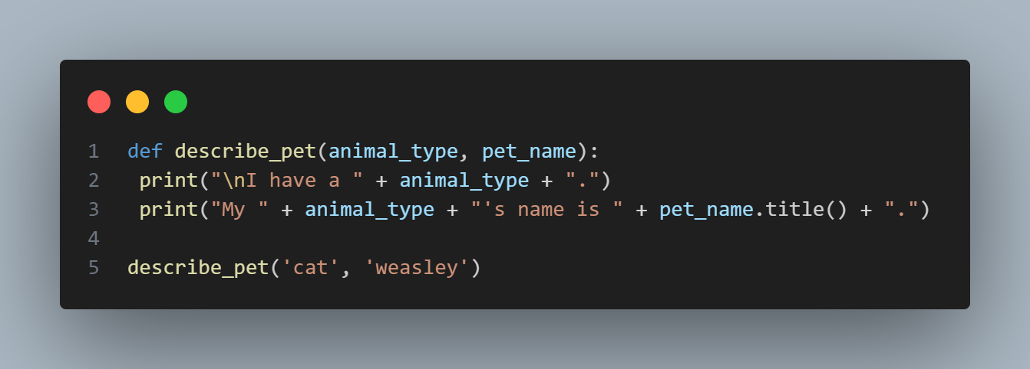
Positional Arguments
You can have multiple function calls throughout the life of the program.
Be careful with positional arguments… order matters!!
Notes:
def describe_pet(animal_type, pet_name):
print("\nI have a " + animal_type + ".")
print("My " + animal_type + "'s name is " + pet_name.title() + ".")
describe_pet('cat', 'weasley')

Slide 9
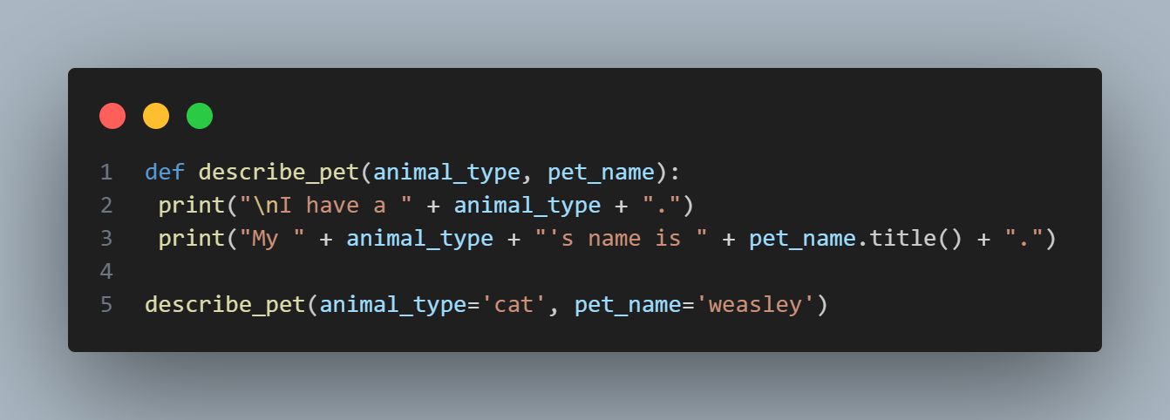
Keyword Arguments
Order does not matter as much with this. We are specifying what the information is associated with.
Notes:
def describe_pet(animal_type, pet_name):
print("\nI have a " + animal_type + ".")
print("My " + animal_type + "'s name is " + pet_name.title() + ".")
describe_pet(animal_type='cat', pet_name='weasley')

Slide 10
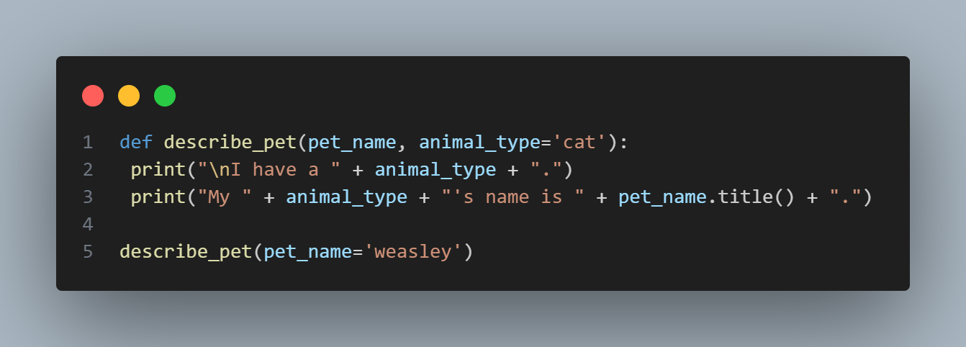
Default Values
What if you do not know one of the arguments? Well, you can set a default value in the parameters that will run if you do not provide an argument!
Notes:
def describe_pet(pet_name, animal_type='cat'):
print("\nI have a " + animal_type + ".")
print("My " + animal_type + "'s name is " + pet_name.title() + ".")
describe_pet(pet_name='weasley')

Slide 11
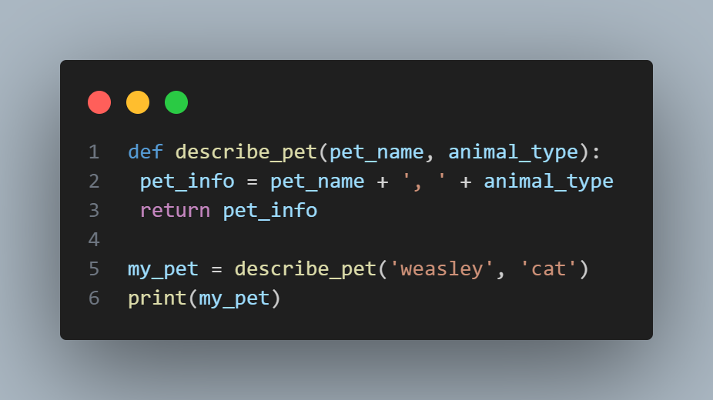
Return Values
A function doesn’t always have to display its output directly. Instead, it can process some data and then return a value or set of values.
RETURN statement: takes a value from inside a function and sends it back to the line that called the function
Notes:
def describe_pet(pet_name, animal_type):
pet_info = pet_name + ', ' + animal_type
return pet_info
my_pet = describe_pet('weasley', 'cat')
print(my_pet)

Slide 12
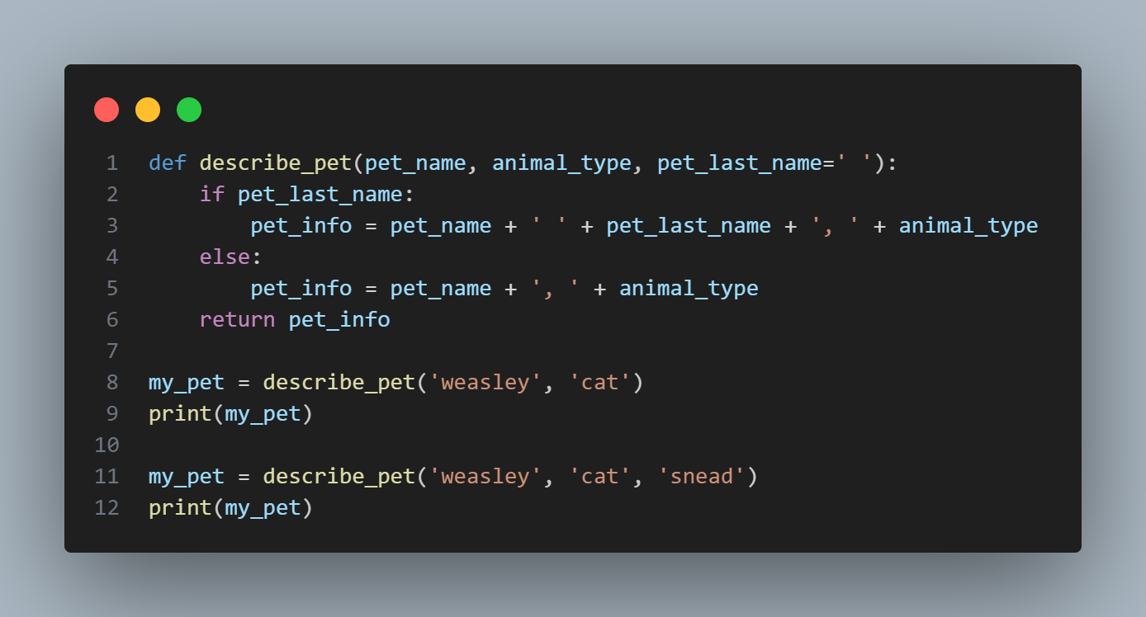
Optional Arguments
Notes:
def describe_pet(pet_name, animal_type, pet_last_name=' '):
if pet_last_name:
pet_info = pet_name + ' ' + pet_last_name + ', ' + animal_type
else:
pet_info = pet_name + ', ' + animal_type
return pet_info
my_pet = describe_pet('weasley', 'cat')
print(my_pet)
my_pet = describe_pet('weasley', 'cat', 'snead')
print(my_pet)

Slide 13
Possibilities are endless on what you can do with functions. You can use it with lists, dictionaries, and loops too!

Slide 14
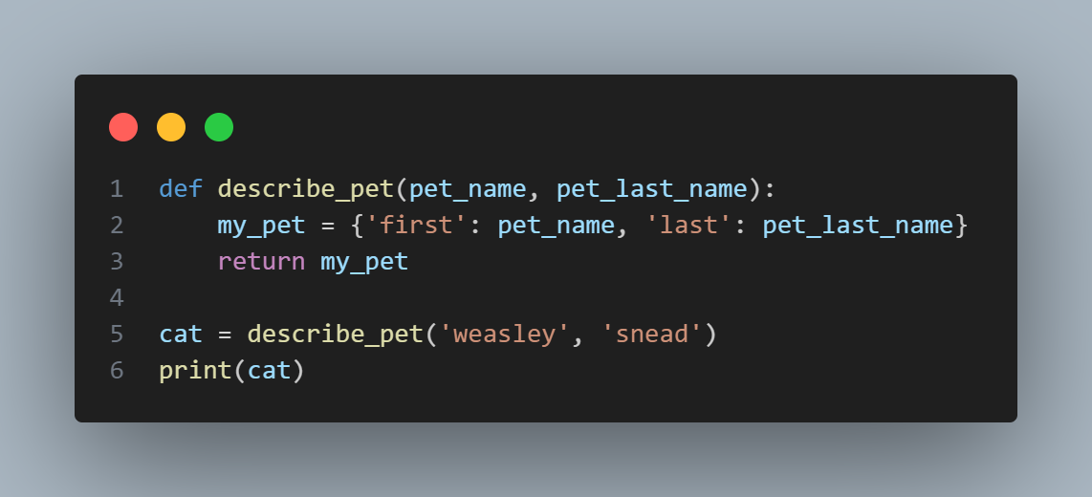
Dictionaries and Functions
Notes:
def describe_pet(pet_name, pet_last_name):
my_pet = {'first': pet_name, 'last': pet_last_name}
return my_pet
cat = describe_pet('weasley', 'snead')
print(cat)

Slide 15
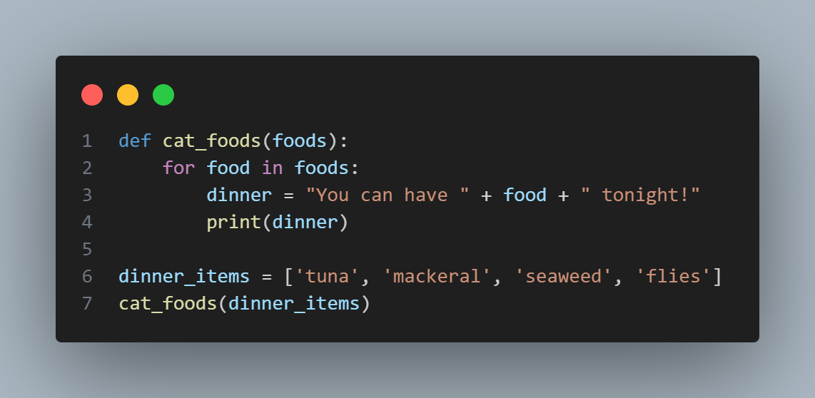
When you pass a list to a function, the function gets direct access to the contents of the list. Look at this example of functions with a for loop:
Notes:
def cat_foods(foods):
for food in foods:
dinner = "You can have " + food + " tonight!"
print(dinner)
dinner_items = ['tuna', 'mackeral', 'seaweed', 'flies']
cat_foods(dinner_items)

Slide 16
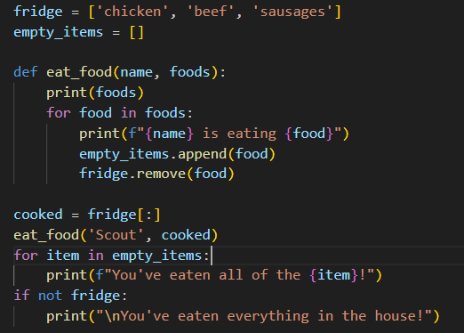
Modifying lists from a function
Notes:
dinner_items = ['tuna', 'mackerel', 'seaweed', 'flies']
empty_items = []
while dinner_items:
current_foods = dinner_items.pop()
print("you have this: " + current_foods)
empty_items.append(current_foods)
print("You have eaten " )
for empty_item in empty_items:
print(empty_item)
print("so we have no more!")

Slide 17
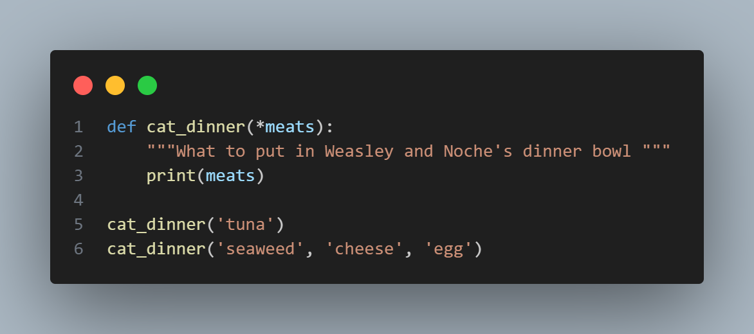
Passing an Arbitrary Number of Arguments
Sometimes you won’t know ahead of time how many arguments a function needs to accept. Fortunately, Python allows a function to collect an arbitrary number of arguments from the calling statement.
Use a *
Notes:
def cat_dinner(*meats):
"""What to put in Weasley and Noche's dinner bowl """
print(meats)
cat_dinner('tuna')
cat_dinner('seaweed', 'cheese', 'egg')

Slide 18
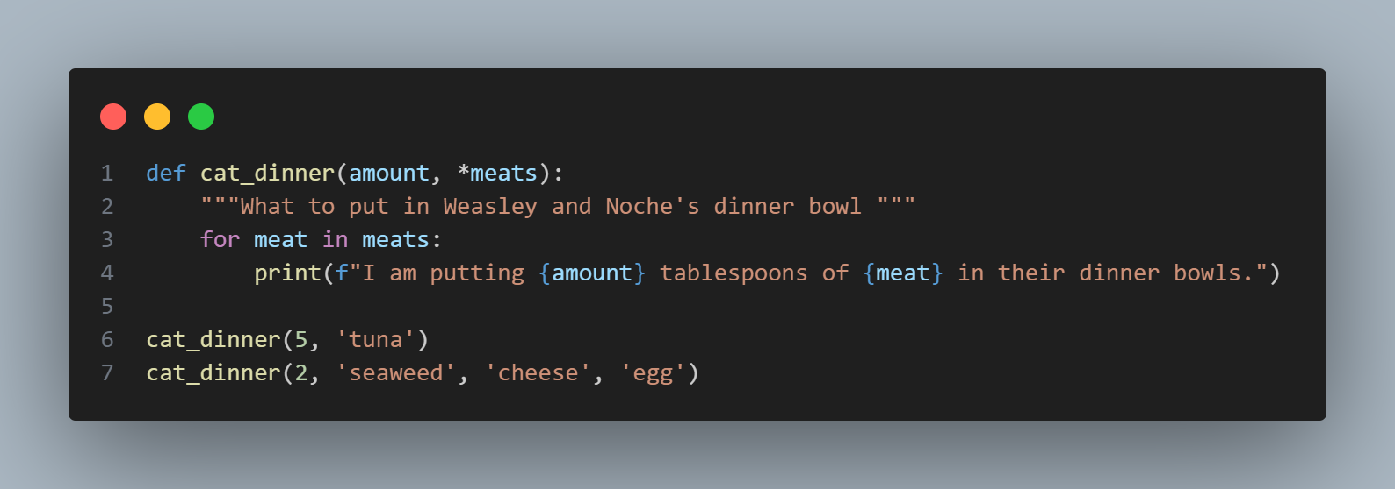
Mixing Positional and Arbitrary Arguments
Notes:
def cat_dinner(amount, *meats):
"""What to put in Weasley and Noche's dinner bowl """
for meat in meats:
print(f"I am putting {amount} tablespoons of {meat} in their dinner bowls.")
cat_dinner(5, 'tuna')
cat_dinner(2, 'seaweed', 'cheese', 'egg')

Slide 19
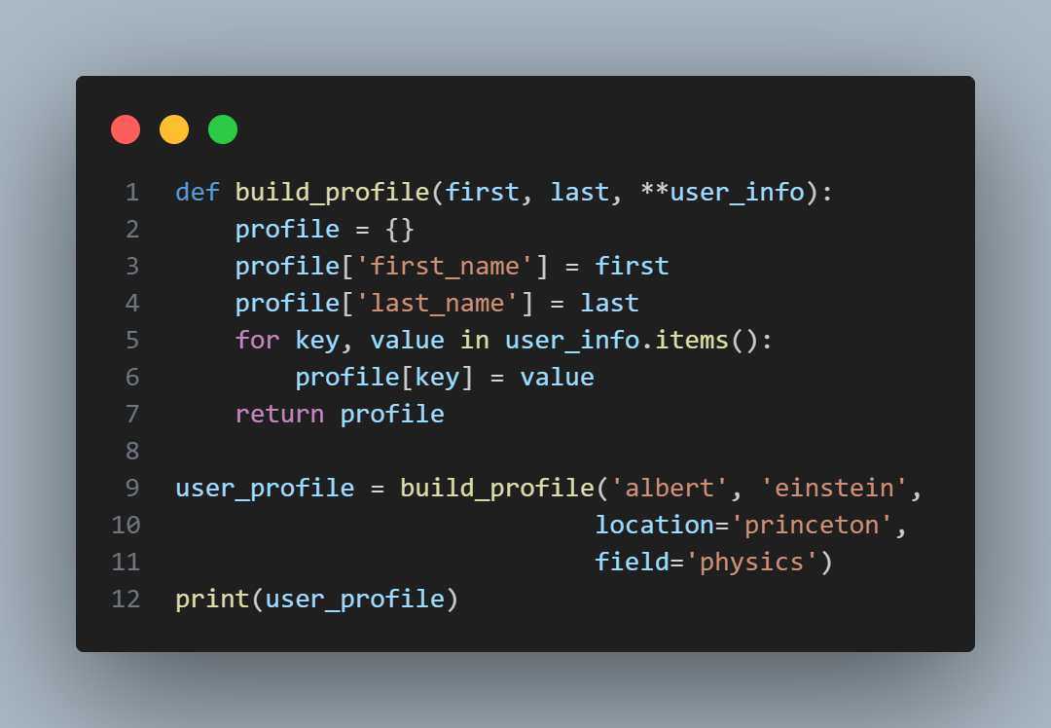
Using Arbitrary Keyword Arguments
** allows you to make an empty dictionary to store information
Sometimes you’ll want to accept an arbitrary number of arguments, but you won’t know ahead of time what kind of information will be passed to the function
Notes:
def build_profile(first, last, **user_info):
profile = {}
profile['first_name'] = first
profile['last_name'] = last
for key, value in user_info.items():
profile[key] = value
return profile
user_profile = build_profile('albert', 'einstein',
location='princeton',
field='physics')
print(user_profile)

Slide 20
Modules
You can go a step further by storing your functions in a separate file called a module and then importing that module into your main program. An import statement tells Python to make the code in a module available in the currently running program file.
Notes:
import weasley
weasley.cat_dinner('tuna')
weasley.cat_dinner('seaweed', 'cheese', 'egg')
#above is for main file
weasley.cat_dinner('tuna')
weasley.cat_dinner('seaweed', 'cheese', 'egg')
#above is for second file

Slide 21
Importing Specific Functions
from module_name import function_name
Notes:
from weasley import cat_dinner
weasley.cat_dinner('tuna')
weasley.cat_dinner('seaweed', 'cheese', 'egg')

Slide 22
You can give your function an alias using ‘as’
Notes:
from weasley import cat_dinner as c_d
weasley.c_d('tuna')
weasley.c_d('seaweed', 'cheese', 'egg')

Slide 23
You can import all functions using *
Notes:
from weasley import *

Slide 24
Well done! Now let’s complete Exercise 8: Functions

